Slide 1

CSCI 1102 Computer Science 2
Meeting 6: Tuesday 2/16/2021
More on Stacks

Slide 2
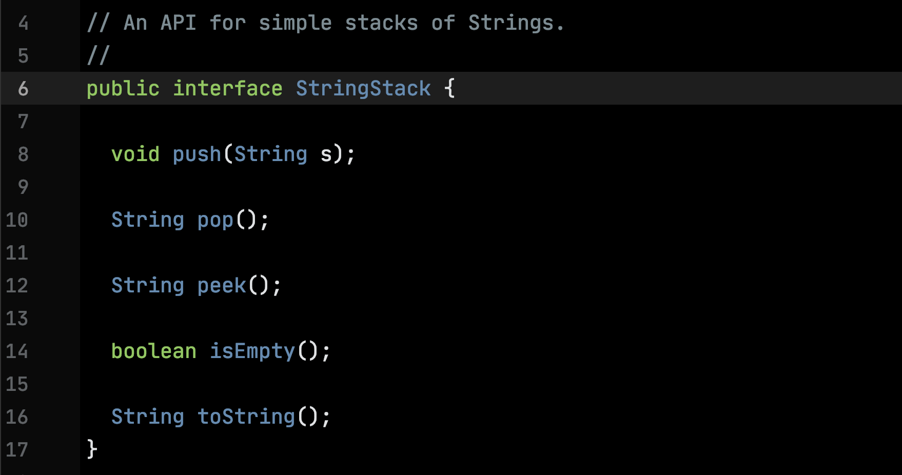

Slide 3
StringStack ADT Code

Slide 4
Improving the StringStack ADT
Make it polymorphic – stack can house values of any reference type;
Make it grow and shrink as needed
A Linked Representation

Slide 5
Object-Oriented Programming We’ll learn enough about it to peacefully co-exist with it.

Slide 6
Object-Oriented Programming Message Passing + Inheritance

Slide 7
Inheritance
In OO, types are organized in an is-a hierarchy.
Pet
Dog
Cat

Slide 8
Inheritance
In OO, types are organized in an is-a hierarchy.
Superclass
Subclass
Pet
Dog
Cat

Slide 9
The is-a relation is transitive: a pet is a mammal and a cat is a pet so a cat is a mammal
Object
Mammal
Pet
Human
Dog
Cat

Slide 10
Every class that we write implicitly extends a root class Object, either directly or indirectly.
Object
Mammal
Pet
Human
Dog
Cat

Slide 11
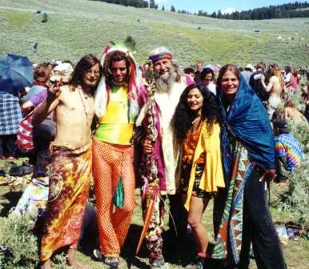


Everything is an Object…

Slide 12
Code that we’ve written for superclasses can be inherited by subclasses. We don’t have to rewrite that code!
Object
Mammal
Pet
Human
Dog
Cat

Slide 13
The MetalComboBoxButton

Slide 14
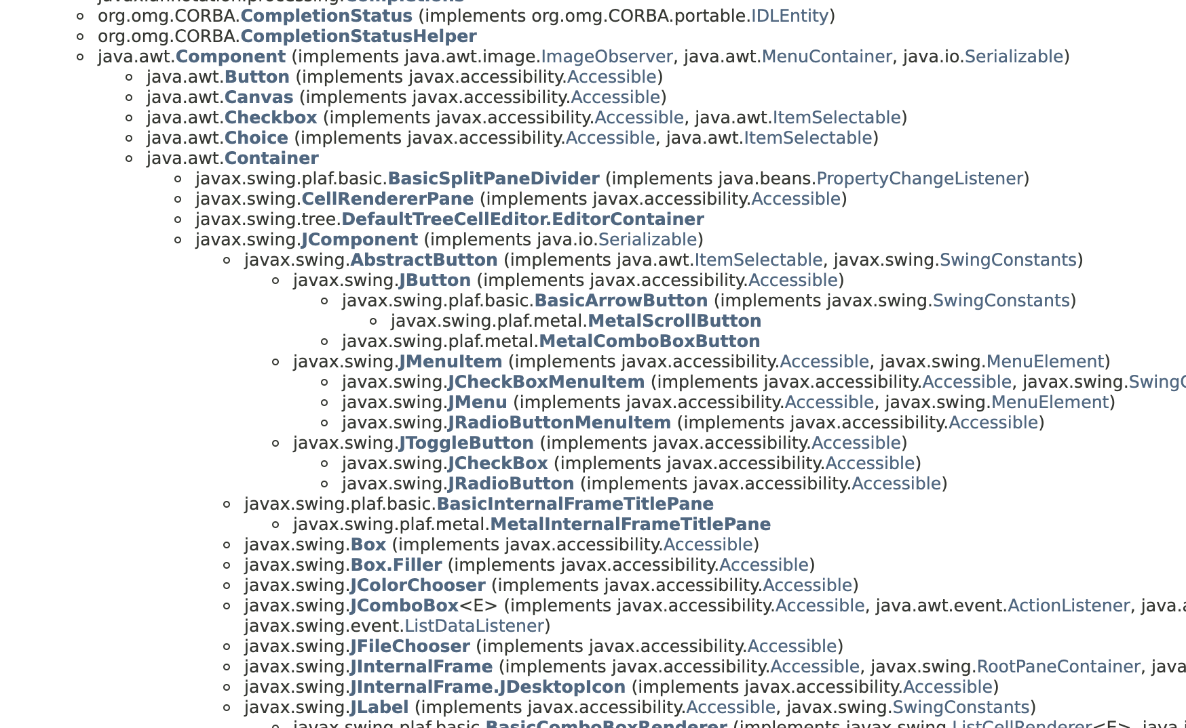

Slide 15
Pet:
String getOwner() {…}
String getName() {…}
double getWeight() {…}
String says() {…}
Dog:
getOwner, getName, getWeight are inherited by Dog. Dog overrides the says function.
@Override
String says() {
return “Woof”;
}

Slide 16
Three Problems

Slide 17
Problem 1: Category Errors

Slide 18
Not all Pets are Mammals.
Amphibians
Mammal
Pet
Frog
Cat

Slide 19
Pet
Dog
Cat
Coyote
Panther

Slide 20
is-a Hierarchies
Real life systems are complicated and generally don’t conform to simple, transitive is-a hierarchies;
This leads to the development of artificially complex inheritance hierarchies;
The code base becomes brittle, hard to maintain, hard to extend, easy to break.

Slide 21
Problem 2: Inheritance isn’t modular

Slide 22
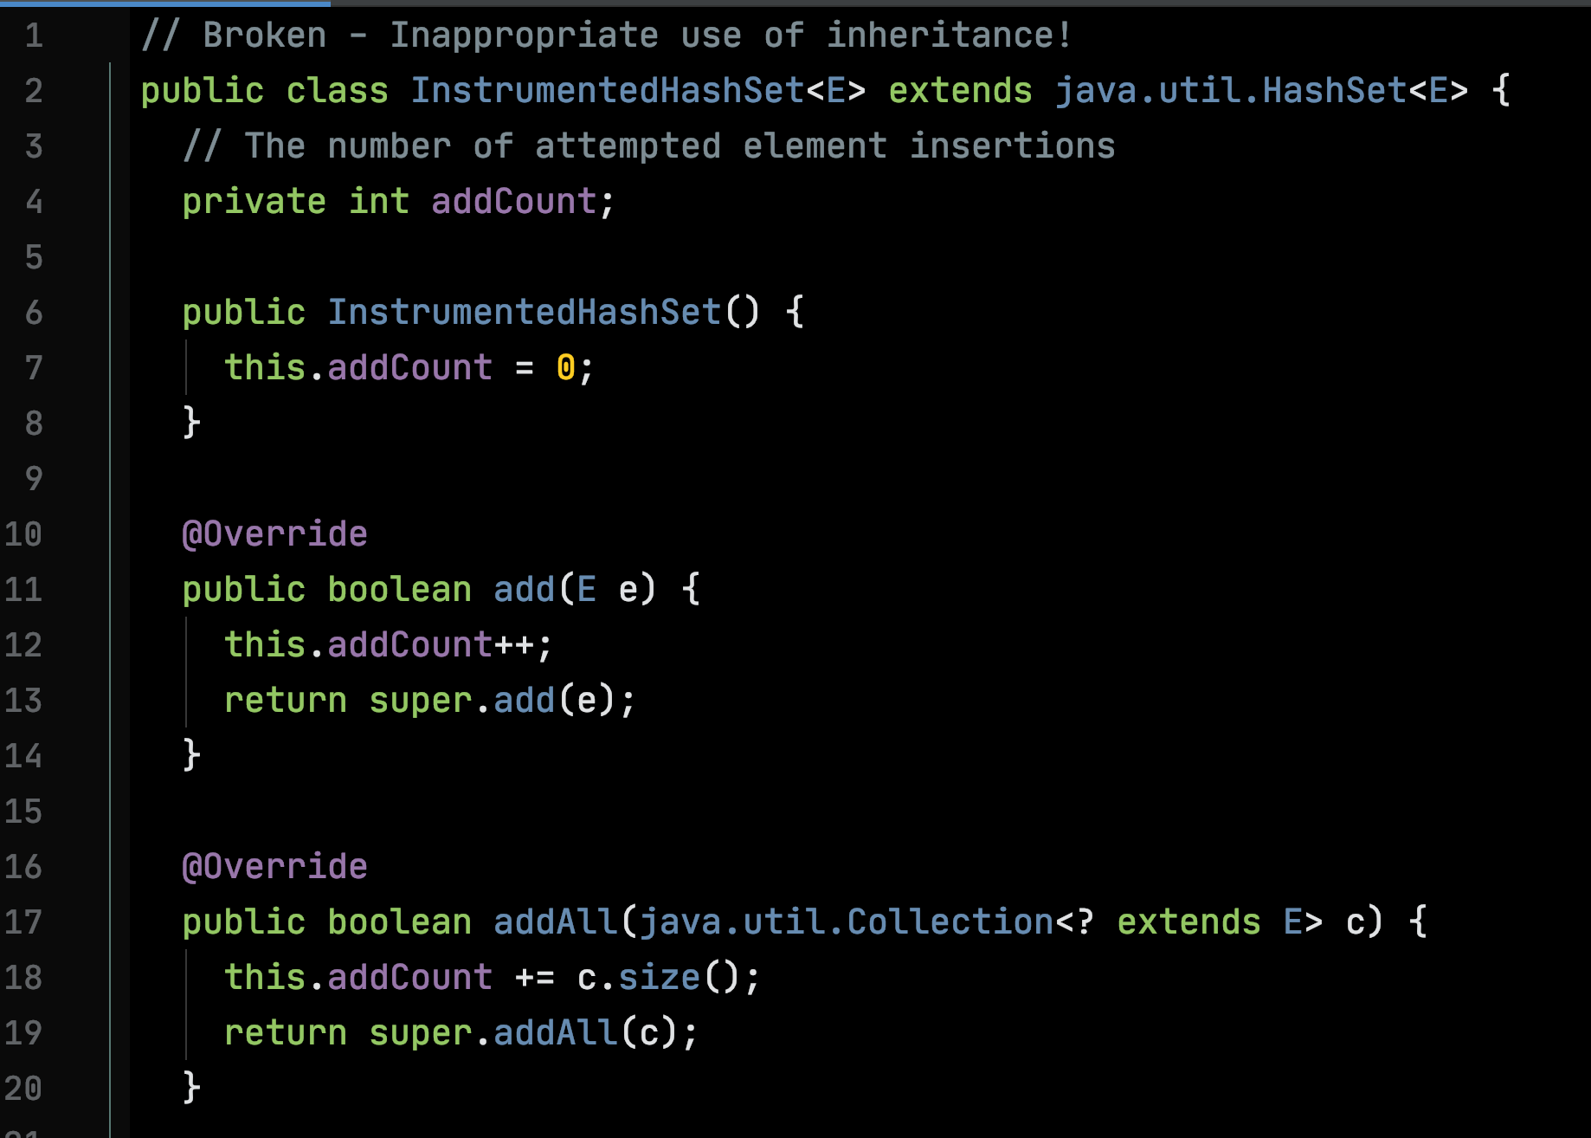

Slide 23
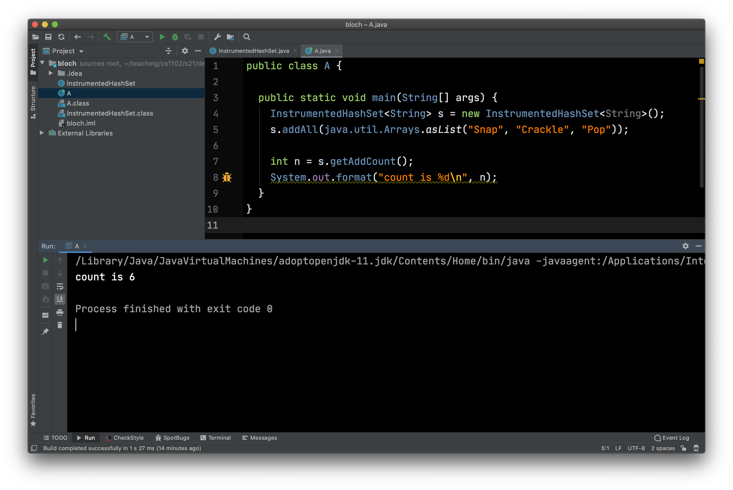

Slide 24
Problem 3: Inheritance is slow.

Slide 25
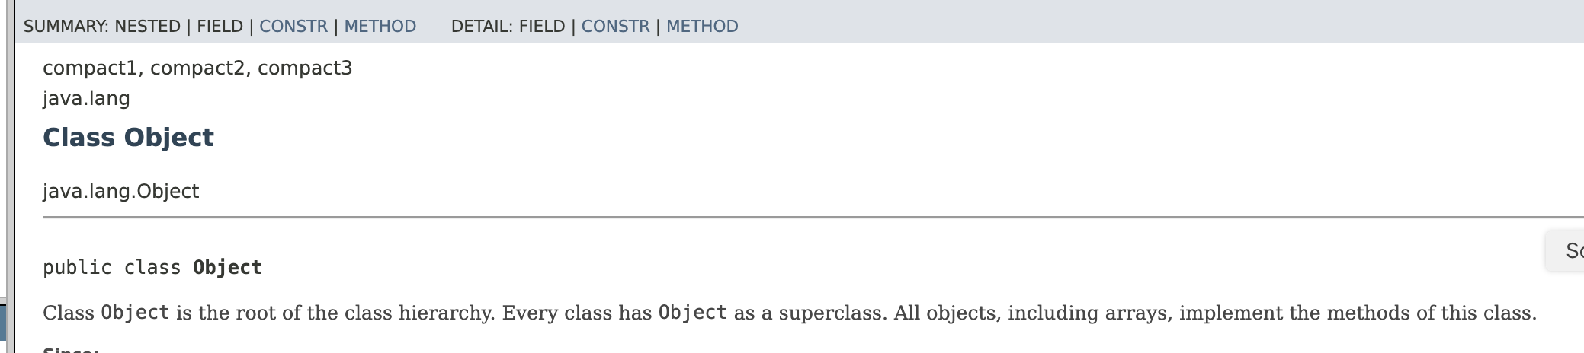
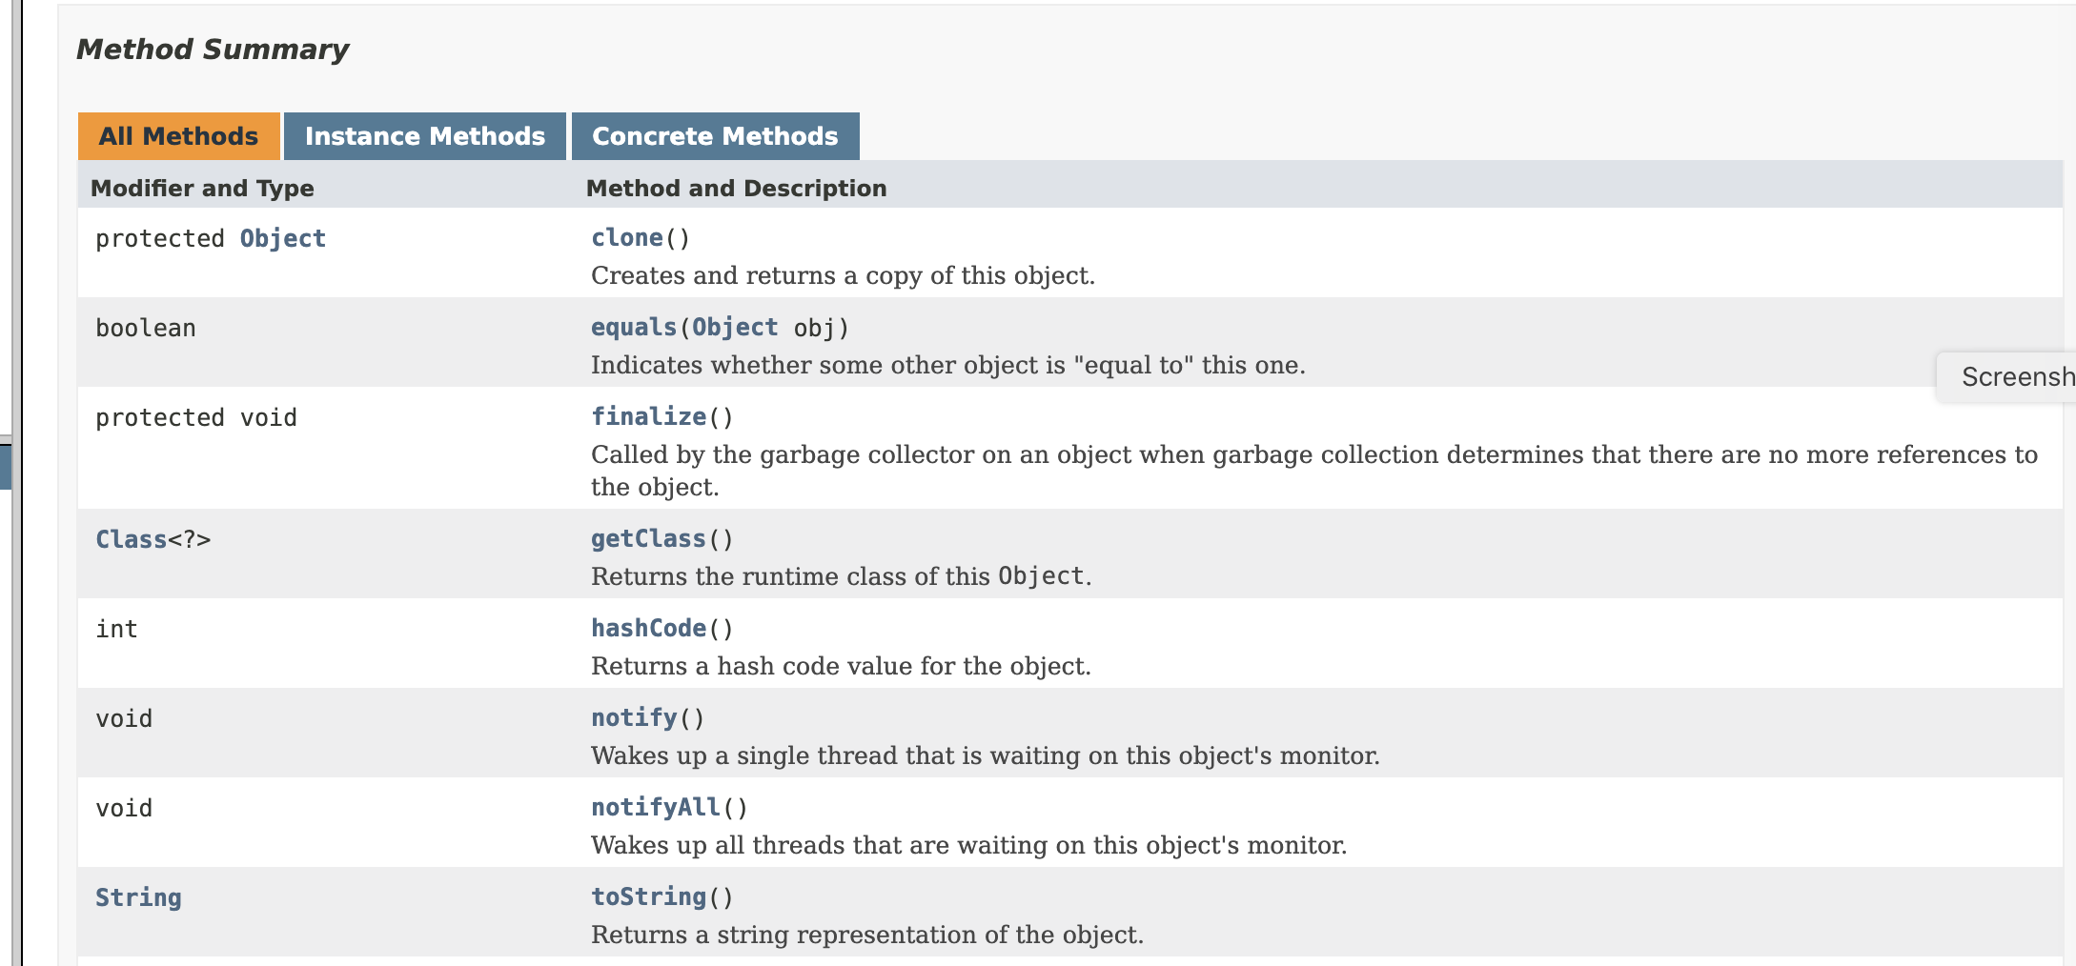

Slide 26
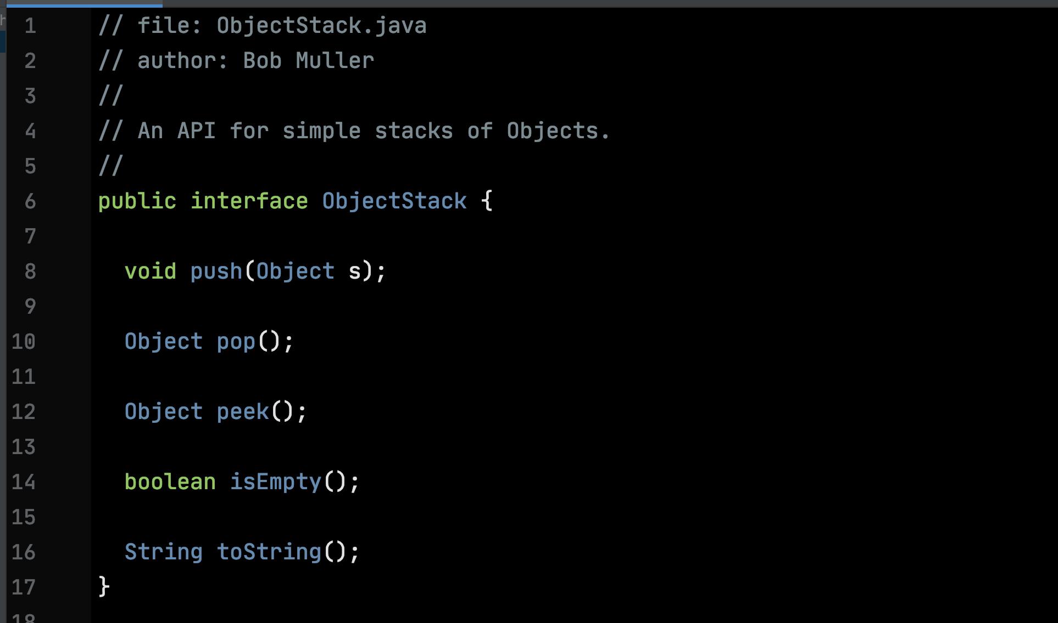
Pre-Generic Style – this is obsolete but you’ll see it.
Since everything is an Object, the stack can house anything.

Slide 27
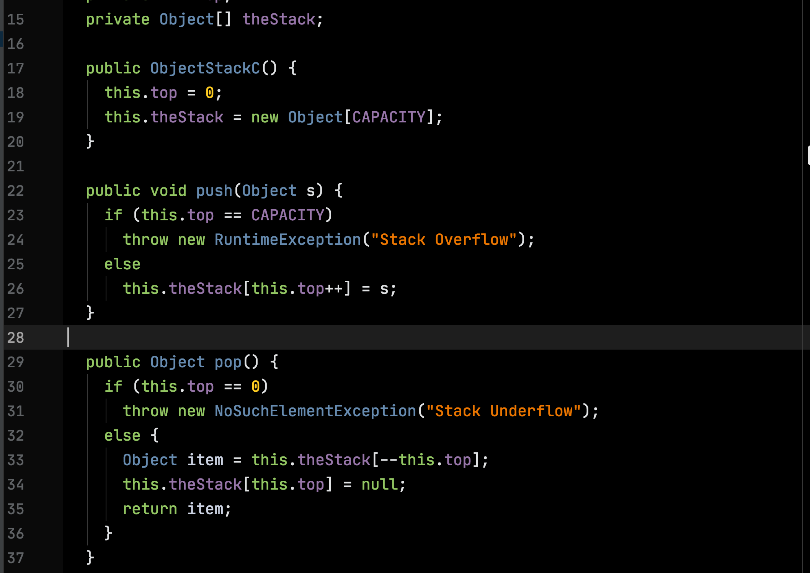

Slide 28
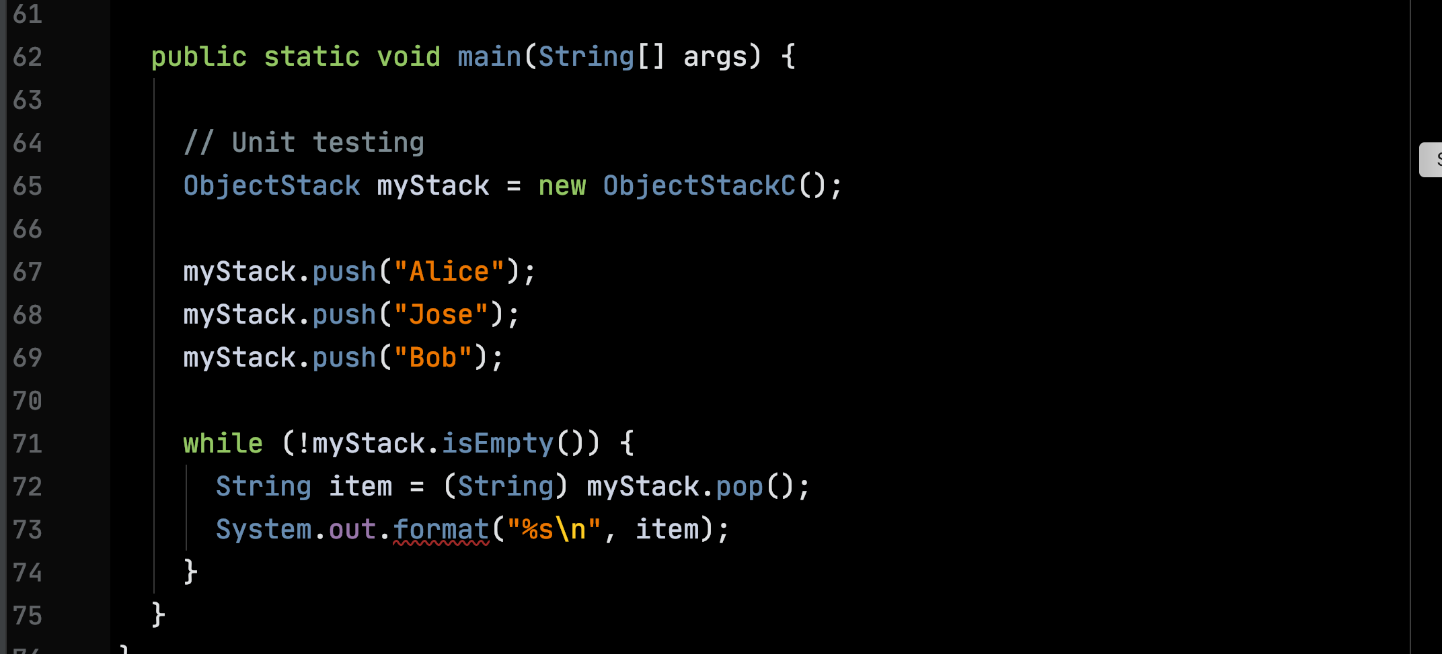
Downcast required

Slide 29
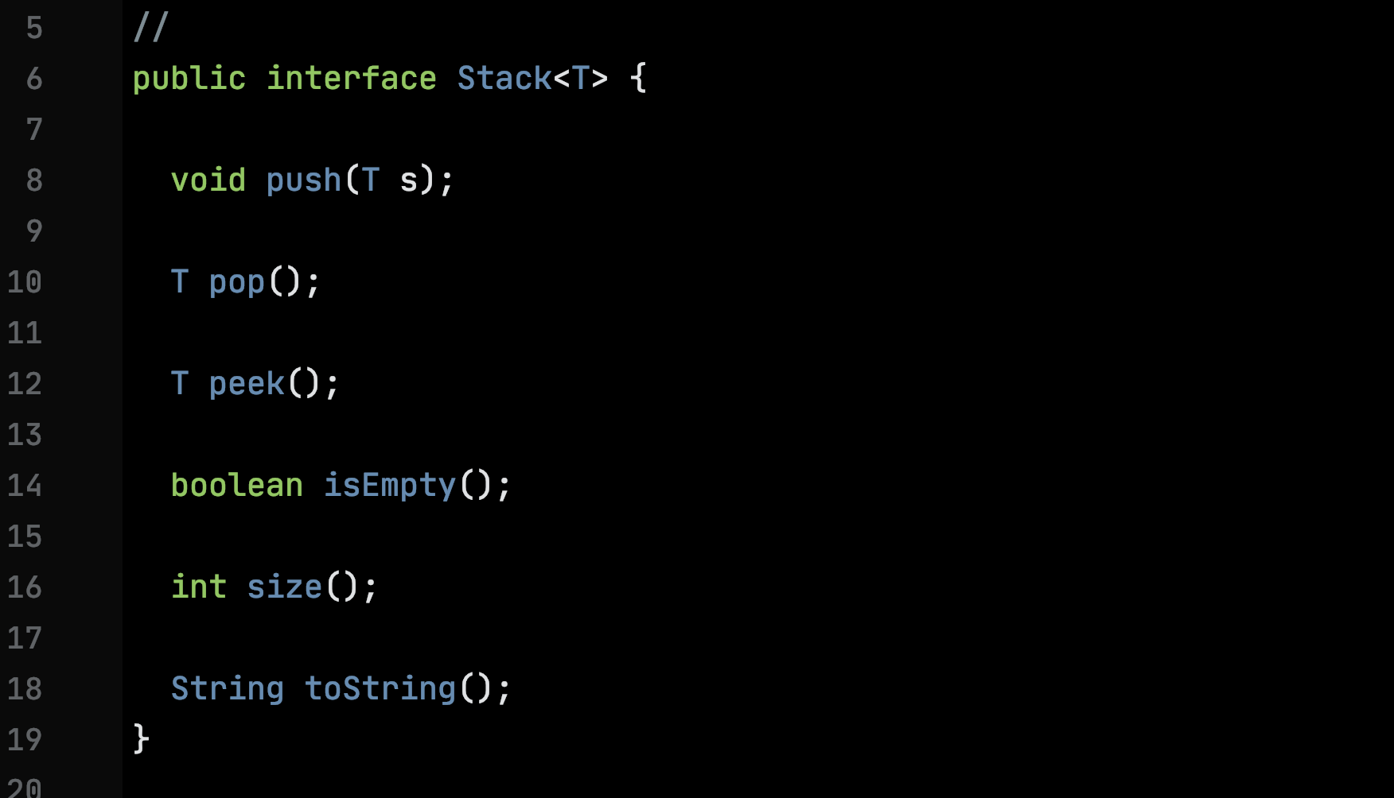
Generic type variables

Slide 30
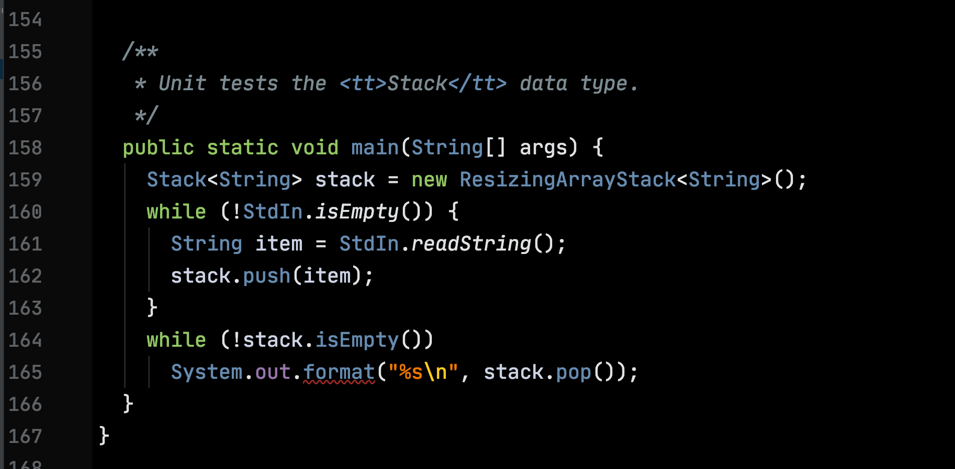
Types for the type variables

Slide 31
Resizing

Slide 32
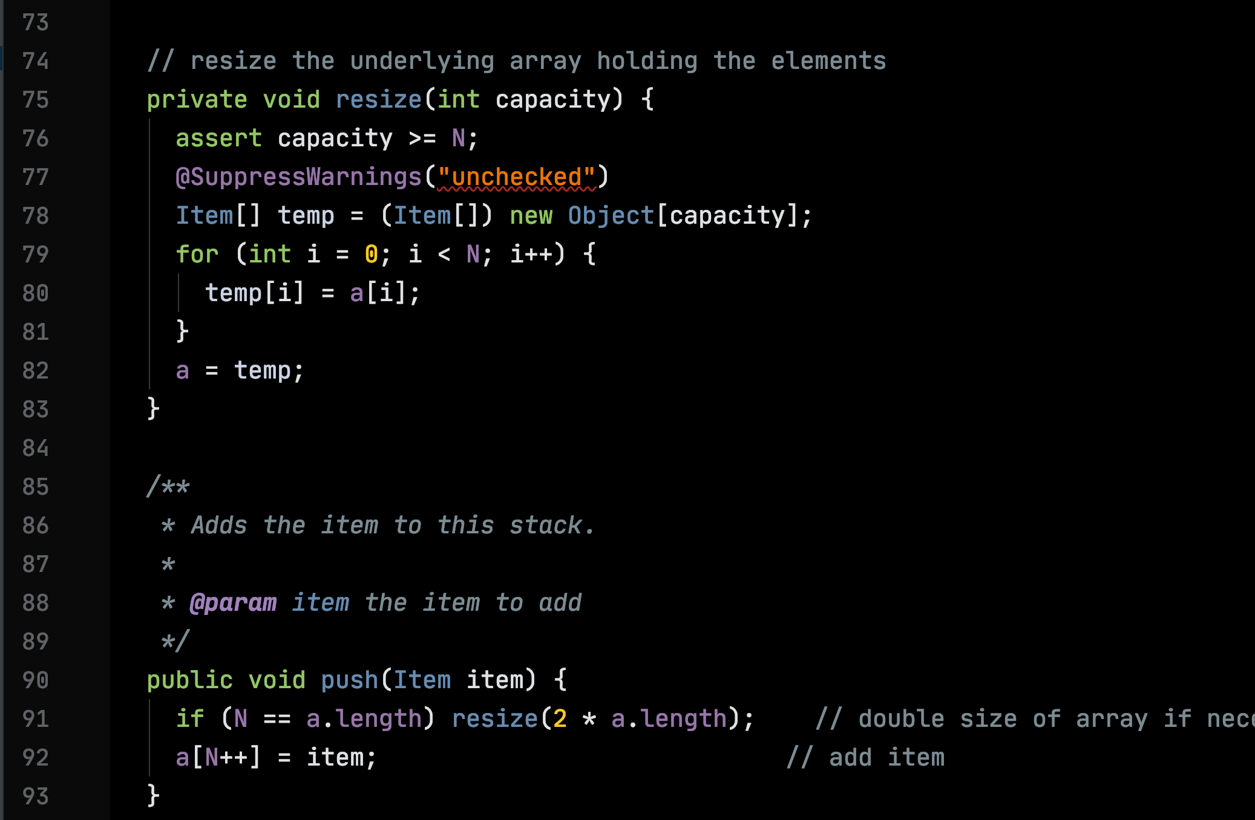
Storage for a now free

Slide 33
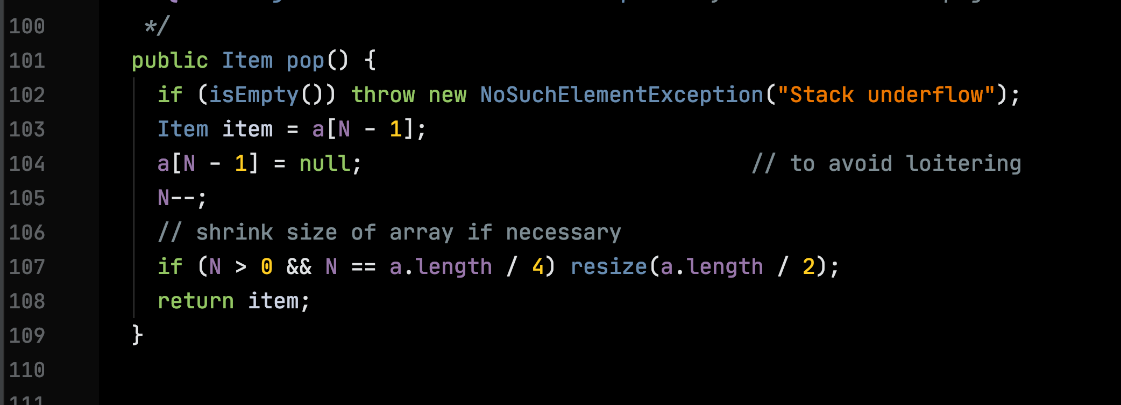
Only using ¼, free it

Slide 35
Pet:
String getOwner()
String getName()
double getWeight()
String says()
Pet:

Slide 36
A Linked Implementation of the StringStack ADT

Slide 37
Work

Slide 38
How Much?
How much time does an operation take?
How much memory does it use?
In the worst case? On average?
How does the work grow as the input grows?

Slide 39
Measure the Input Size – N
Units of Work
Input Size – N

Slide 40
Memory

Slide 41
Basic unit of storage is the byte
7
4
3
0
0
1
0
1
1
0
1
0

Slide 42
There are 2⁸ = 256 8-bit patterns
0
0
0
0
0
0
0
0
…
1
1
1
1
1
1
1
1

Slide 43
We can abbreviate 4 bits with one hexadecimal (base 16) digit
Binary | Hex | Binary | Hex
0000 | 0 | 1000 | 8
0001 | 1 | 1001 | 9
0010 | 2 | 1010 | A
0011 | 3 | 1011 | B
0100 | 4 | 1100 | C
0101 | 5 | 1101 | D
0110 | 6 | 1110 | E
0111 | 7 | 1111 | F

Slide 44
Abbreviate an 8-bit byte with a pair of hex digits
7
4
3
0
0
1
0
1
1
0
1
0
5
A
0x5A

Slide 45
Memory Organization

Slide 46
Mostly Random Access Memory (RAM)
Ephemeral Memory
Persistent
Storage
Flash Drive

Slide 47
RAM: Contiguously allocated bytes – each byte has a numerical address
Address
0000
0x00
An 8-bit pattern
0001
0x00
Addresses are natural numbers
0002
0x00
0003
0x00

Slide 48
Words – 8 consecutive bytes
Address
0x0000
0x 07 06 05 04 03 02 01 00
0x0008
0x 07 06 05 04 03 02 01 00
0x0010
0x 07 06 05 04 03 02 01 00
0x0018
0x 07 06 05 04 03 02 01 00

Slide 49
Variables often hold Addresses
Address
0x0008
0x0000
0x 07 06 05 04 03 02 01 00
0x0008
0x 07 06 05 04 03 02 01 00
0x0010
0x 07 06 05 04 03 02 01 00
0x0018
0x 07 06 05 04 03 02 01 00

Slide 50
In diagrams, addresses are usually depicted abstractly as arrows
Address
0x0008
0x0000
0x 07 06 05 04 03 02 01 00
0x0008
0x 07 06 05 04 03 02 01 00
0x0010
0x 07 06 05 04 03 02 01 00
0x0018
0x 07 06 05 04 03 02 01 00

Slide 51
Ephemeral Memory
System Space
User Space

Slide 52
User Space
Dynamic Memory
Static Memory

Slide 53
User Space
Dynamic Memory
Data
Static Memory
Code

Slide 54
Static Memory
Data Segment
Images
Text Segment
Data Segment
Text Segment
Data Segment
Text Segment

Slide 55
All function/method definitions can be understood as images residing in static memory

Slide 56
Dynamic Memory
Stack
Heap

Slide 57
Dynamic Memory
Storage for function variables
Stack
Storage for large values (e.g., arrays) & long-living values
Heap

Slide 58
The Call Stack: Call Frames/Activation Records
function name
a = …
…
Word-size slots for local variables.
z = …
Body of function evaluated with respect to a call frame.

Slide 59
Managing Dynamic Memory
The stack: the compiler generates code that manages the allocation and deallocation of call frames on the call stack
A call frame is placed on top of the stack on function call and removed on function return
The heap: managed by a run-time support routine called a garbage collector.

Slide 60
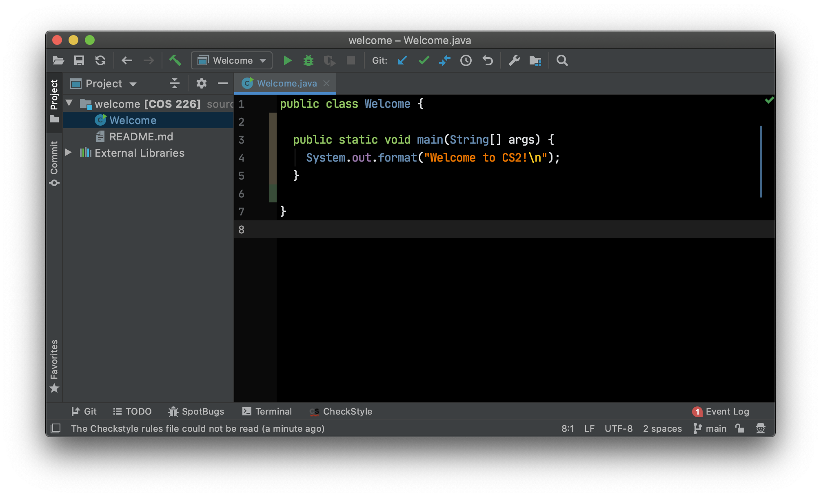
Example

Slide 61
Stack
Heap

Slide 62
Stack
Heap
Welcome.main
args
0

Slide 63
top
Heap
Stack
16
'W'
System.out.format
'e'
…
Welcome.main
'!'
args
0
'\n'

Slide 64
Stack
Heap
top
16
'W'
System.out.format
'e'
…
Welcome.main
'!'
args
0
'\n'

Slide 65
Stack
Heap
16
'W'
System.out.format
'e'
…
Welcome.main
'!'
args
0
'\n'

Slide 66
Stack
Heap
16
'W'
'e'
…
'!'
0
'\n'

Slide 67
Stack
Heap

